Slide 1


IT Project Management
Week 3 : Project Management Process group
Note:
Adapted from slide of the textbook: Schwalbe, Kathy. Managing Information Technology Project – Eight Edition. Boston, MA: Thomson Course Technology, 2016.
See the text itself for full citations.

Slide 2
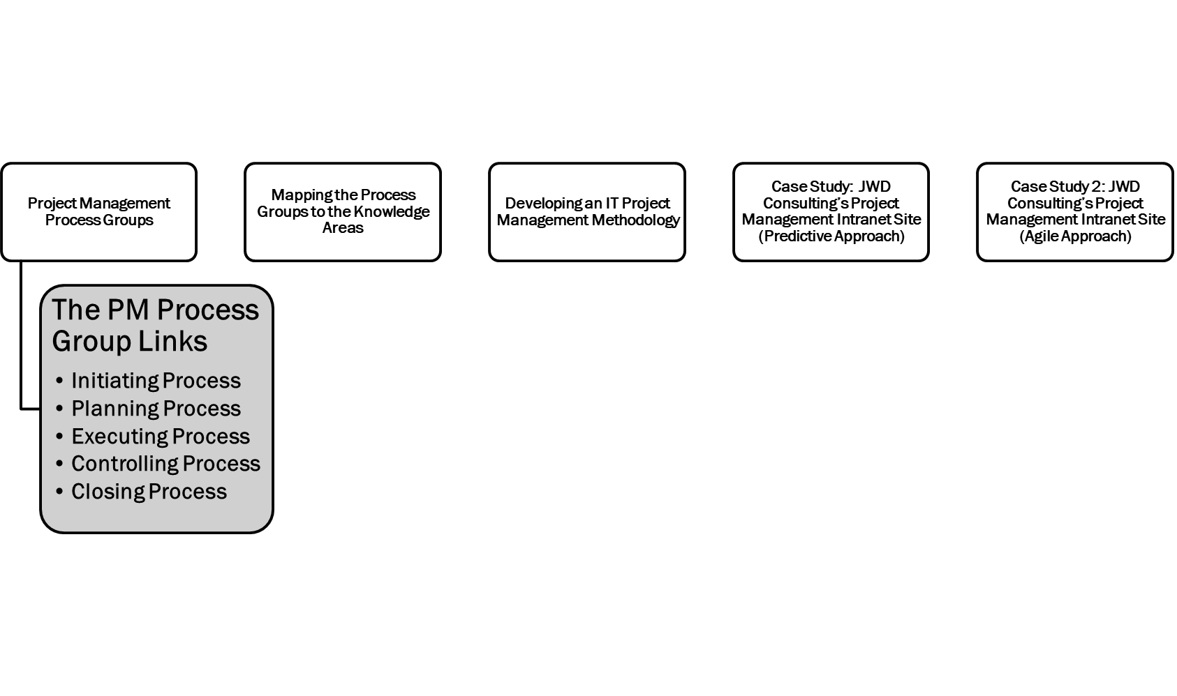
Mind Map

Slide 3
Learning Objectives
PART 1 -> Available in Video Material
Describe the five project management process groups, the typical level of activity for each, and the interactions among them
Understand how the project management process groups relate to the project management knowledge areas
Discuss how organizations develop information technology (IT) project management methodologies to meet their needs
PART 2
Review a case study of an organization applying the project management process groups to manage an IT project, describe outputs of each process group, and understand the contribution that effective initiating, planning, executing, monitoring and controlling, and closing make to project success
Review the same case study of a project managed with an agile focus to illustrate the key differences in approaches
Describe several templates for creating documents for each process group

Slide 4
Part 1.A: Project management process group

Slide 5
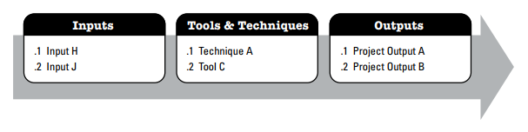
Project Management Process Groups
A process is a series of actions directed toward a particular result
Project management can be viewed as a number of interlinked processes
Every project management process produces one or more outputs from one or more inputs by using appropriate project management tools and techniques
A project can have different combinations of phases. But all projects and all project phases need to include all five process groups
One project might have concept, development, implementation, and close-out phases, and another might have initial, intermediate, and final phases
Example Process: Inputs, Tools & Techniques, and Outputs

Slide 6
PM Process Groups and outcome (1/2)
The project management process groups include
initiating processes - defining and authorizing a project or project phase
Outcome : The organization recognizes that a new project exists – completion of a business case and project charter
planning processes - devising and maintaining a workable scheme to ensure that the project addresses the organization’s needs
Outcome : Completing the WBS and scope statement, project schedule and cost estimate

Slide 7
PM Process Groups and outcome (2/2)
executing processes - coordinating people and other resources to carry out the various plans and create the products, services, or results of the project or phase
Outcome : Performing actions necessary to complete the work described in the planning activities
monitoring and controlling processes - regularly measuring and monitoring progress to ensure that the project team meets the project objectives
Outcome : Measuring progress toward the project objectives, monitoring deviation from the plan and taking corrective action to match progress with the plan
closing processes - formalizing acceptance of the project or project phase and ending it efficiently
Outcome : Formal acceptance of the work and creation of closing documents

Slide 8
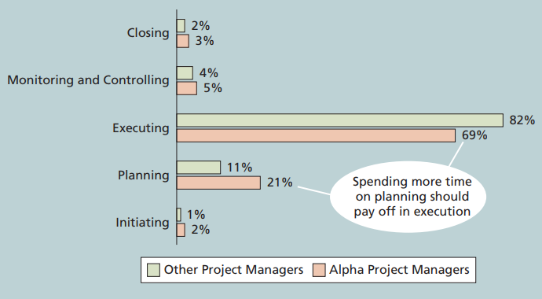
Percentage of Time Spent on Each Process Group

Slide 9
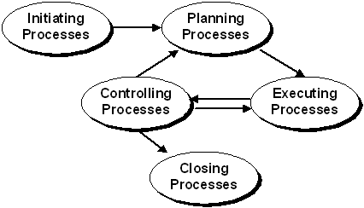
The PM Process Group Links
1. Initiating
2. Planning
3. Executing
4. Monitoring and Controlling
5. Closing
Each process is described by:
Inputs
Tools & Techniques
Outputs

Slide 10
Initiating Process
Defining and authorizing a project or project phase
Inputs
Product Description
Strategic plan
Project Selection Criteria
Historical Information
Outputs
Project charter
Project Manager assigned
Key stakeholders identified
Business case completed

Slide 11
Planning Process
Devising and maintaining a workable scheme to accomplish the business need that the project was undertaken to address
Scope Planning
Scope Definition
Activity Definition
Activity Sequencing
Activity Duration Estimating
Resource Planning
Cost Estimating
Cost Budgeting
Risk Planning
Schedule Development
Quality Planning
Communications Planning
Organization Planning
Staff Acquisition
Procurement Planning
Project Plan Development

Slide 12
Executing Process
Coordinating people and other resources to carry out the plan
Project Plan Execution
Scope Verification
Quality Assurance
Team Development
Information Distribution
Solicitation
Source Selection
Contract Administration

Slide 13
Controlling Process
Ensuring that project objectives are met by monitoring and measuring progress and taking corrective measures when necessary
Overall Change Control
Scope Change Control
Schedule Control
Cost Control
Quality Control
Performance Reporting
Risk Response Control

Slide 14
Closing Process
Formalizing acceptance of the project or phase and bringing it to an orderly end
Administrative Closure
Contract Close-out

Slide 15
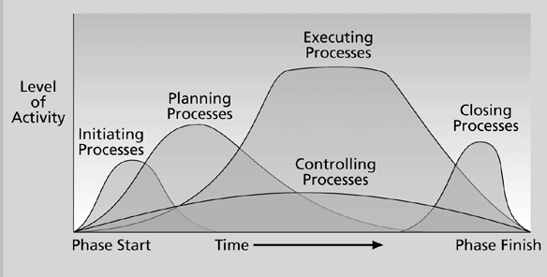
Overlap of Process Groups in a Phase (PMBOK® Guide)

Slide 16
Part 1.b: MaPPing the PrOcess grOuPs tO the KnOWLedge areas

Slide 17
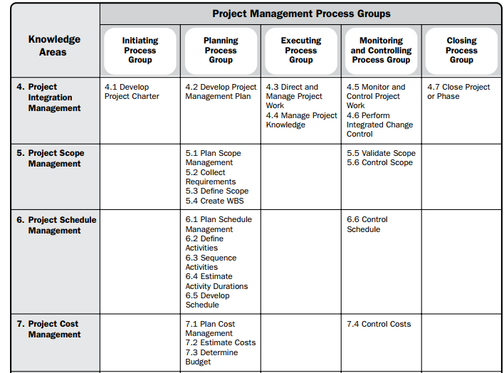
Mapping Project Management Process Groups to Knowledge Areas (1/2)
Note that there are activities from each knowledge area under the planning process groups
*Source: PMBOK® Guide, Sixth Edition, 2017.

Slide 18
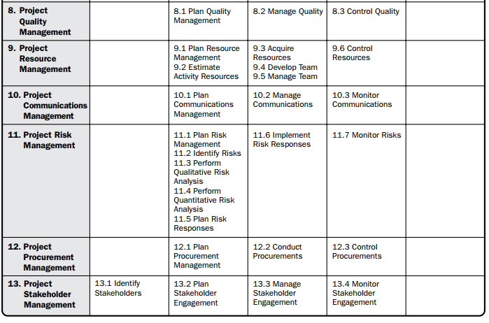
Mapping Project Management Process Groups to Knowledge Areas (2/2)
*Source: PMBOK® Guide, Sixth Edition, 2017.

Slide 19
Part 1.c: deveLOPing an it PrOject ManageMent MethOdOLOgy

Slide 20
Developing an IT Project Management Methodology
Just as projects are unique, so are approaches to project management.
Many organizations develop their own project management methodologies, especially for IT projects
Some organizations spend a great deal of time and money on training efforts for general project management skills, but after the training, project managers may still not know how to tailor their project management skills to the organization’s particular needs.
A standard describes best practices for what should be done to manage a project; e.g the PMBOK Guide
A methodology describes how things should be done, and different organizations often have different ways of doing things
Some project management methodology :
PRINCE2
Agile
RUP
Six Sigma

Slide 21
Part 2 Case study : JWD consulting
Focus Group Discussion

Slide 22
jWd cOnsuLting’s PrOject ManageMent intranet site PrOject
Erica Bell is in charge of the Project Management Office (PMO) for her consulting firm, JWD Consulting, which has grown to include more than 200 full-time consultants and even more part-time consultants. JWD Consulting provides a variety of consulting services to assist organizations in selecting and managing IT projects. The firm focuses on finding and managing high-payoff projects and developing strong metrics to measure project performance and benefits to the organization after the project is implemented. The firm’s emphasis on metrics and working collaboratively with its customers gives it an edge over many competitors.
Joe Fleming, the CEO, wanted his company to continue to grow and become a world-class consulting organization. Because the core of the business is helping other organizations with project management, he felt it was crucial for JWD Consulting to have an exemplary process for managing its own projects. He asked Erica to work with her team and other consultants in the firm to develop several intranet site applications that would allow them to share their project management knowledge. He also thought that the firm should make some of the information available to the firm’s clients. For example, the firm could provide project management templates, tools, articles, links to other sites, and an Ask the Expert feature to help build relationships with current and future clients. Because JWD Consulting emphasizes the importance of high-payoff projects, Joe also wanted to see a business case for this project before proceeding.

Slide 23
Discussion
Consider that JWD will be implementing the project with two different approach, predictive approach (topic A) and agile approach (topic B)
FOCUS GROUP : 40 minutes
You will be divided into focus group that will each discuss the process group in each approach. Each group will consist of 5-6 students. There will be 5 group of topic A (predictive approach) , 5 group of topic B (agile approach)
What are the activities involved in each process groups and the output of the process? Present the document/template for each outputs.
Present your discussion in power point presentation
Use the references available in the course page
HOME GROUP : 30 minutes
You will be regrouped into a group that previously discussed topic A and topic B. Each group will consist of 5-6 students.
What are the differences in the activities on the two approaches?
Present your work in power point presentation

Slide 24
case study 1: jWd cOnsuLting’s PrOject ManageMent intranet site PrOject (Predictive aPPrOach)

Slide 25
Project Pre-initiation
An organization should put considerable thought into project selection to ensure that it initiates the right kinds of projects for the right reasons.
It is good practice to lay the groundwork for a project before it officially starts
Senior managers often perform several pre-initiation tasks, including the following:
Determine the scope, time, and cost constraints for the project
Identify the project sponsor
Select the project manager - The selection of projects for initiation is therefore crucial, as is the selection of project managers
Develop a business case for a project
Meet with the project manager to review the process and expectations for managing the project
Determine if the project should be divided into two or more smaller projects

Slide 26
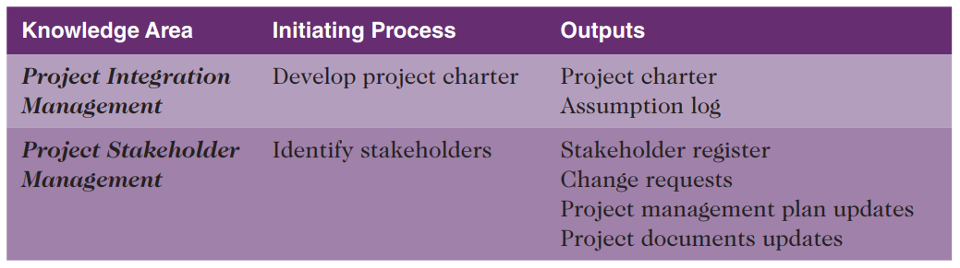
Project Initiation
Initiating a project includes recognizing and starting a new project or project phase
The main goal is to formally select and start off projects

Slide 27
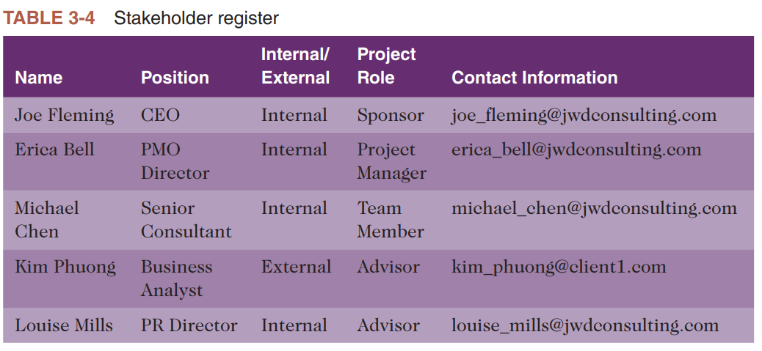
Project Initiation: identifying Project stakeholders (1/2)
Stakeholder Register: a document that includes details related to the identified project stakeholders

Slide 28
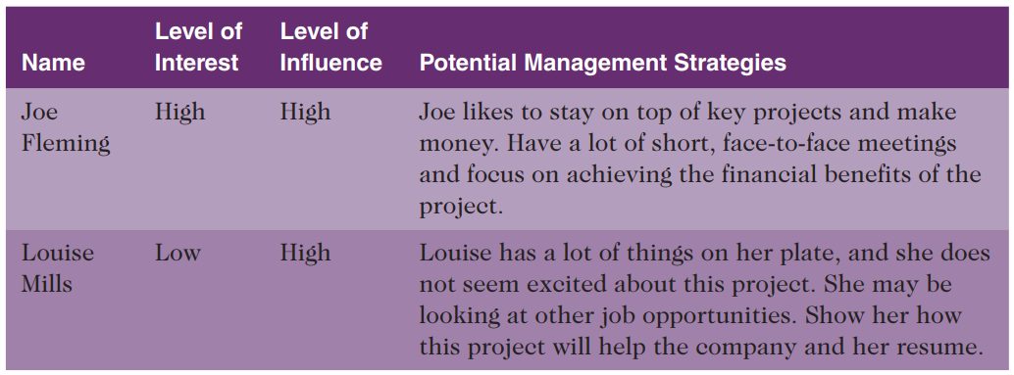
Project Initiation: identifying Project stakeholders (2/2)
A stakeholder analysis is a technique that project managers can use to help understand and increase the support of stakeholders throughout the project
Results of the stakeholder analysis can be documented in a stakeholder register or in a separate stakeholder management strategy.
Because much of this information can be sensitive, it should be considered confidential

Slide 29
Project Initiation: Project Charters and Kick-off Meetings
Charters are normally short and include key project information and stakeholder signatures
It’s good practice to hold a kick-off meeting at the beginning of a project so that stakeholders can meet each other, review the goals of the project, and discuss future plans
The kick-off meeting is often held after the business case and project charter are completed, but it could be held sooner, as needed.

Slide 30
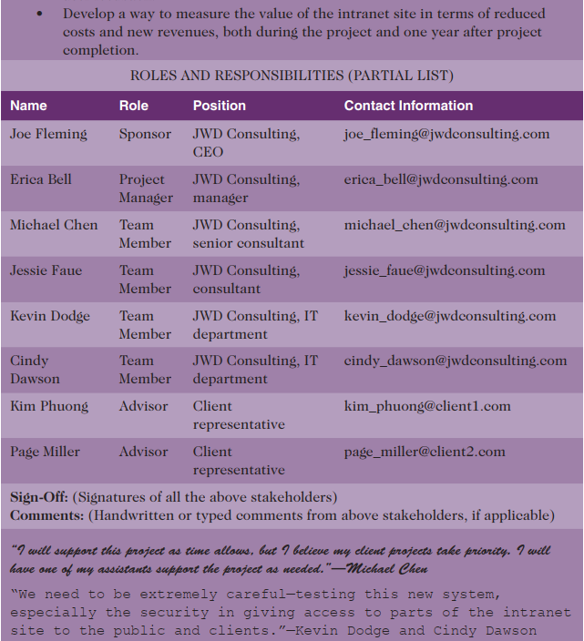
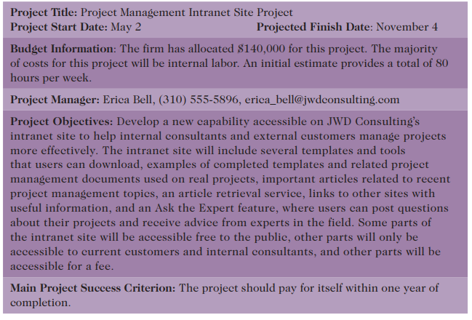
JWD’s Project Charter

Slide 31
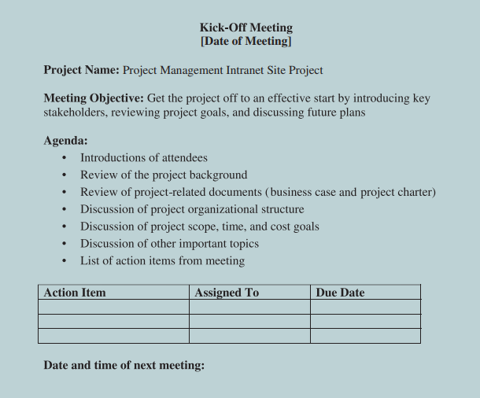
Kick-off Meeting Agenda

Slide 32
Project Planning
The main purpose of project planning is to guide execution
Every knowledge area includes planning information
Key outputs included in the JWD project include:
A team charter, an output of project resource management planning
A project scope statement
A work breakdown structure, a key part of the scope baseline
A project schedule, in the form of a Gantt chart with all dependencies and resources entered
A list of prioritized risks (part of a risk register)

Slide 33
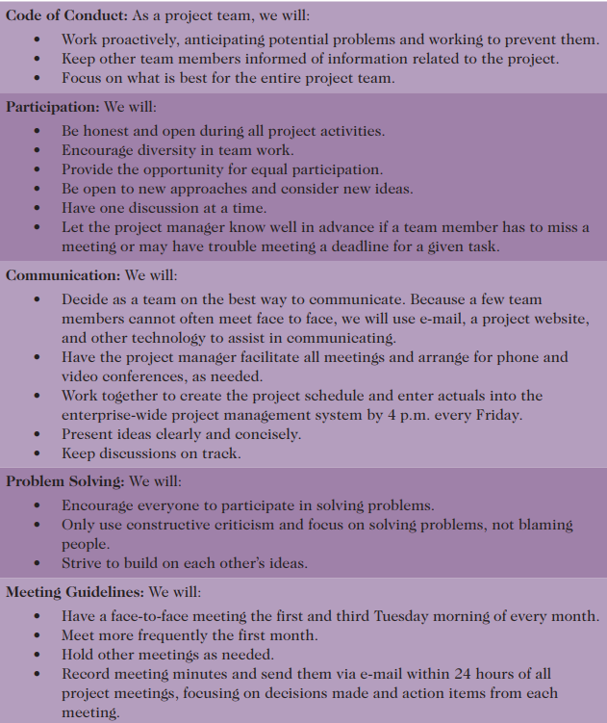
Team charter

Slide 34
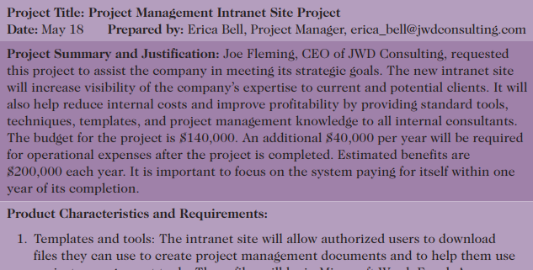
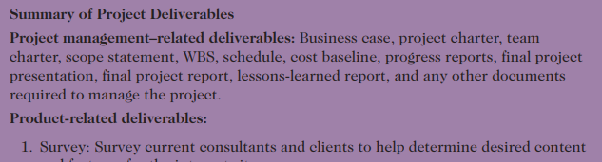

Scope statement draft

Slide 35
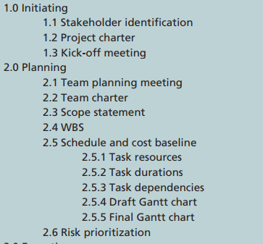
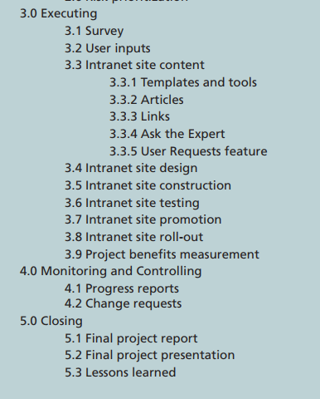
Work breakdown structure

Slide 36
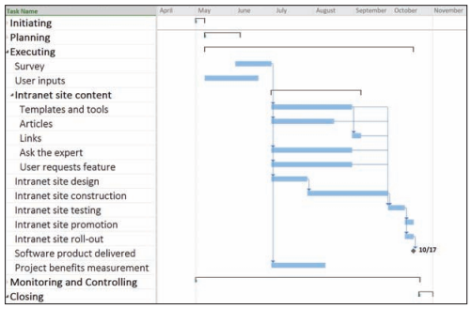
JWD Consulting Intranet Site Project Baseline Gantt Chart

Slide 37
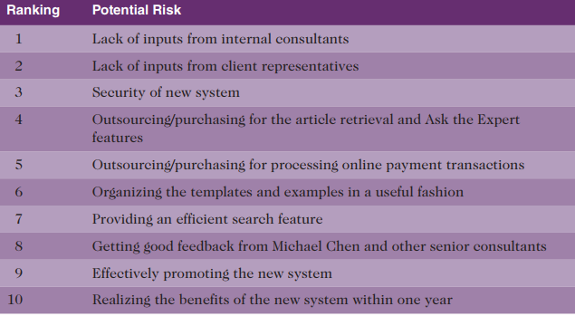
List of Prioritized Risks

Slide 38
Project Executing
Usually takes the most time and resources to perform project execution
Project managers must use their leadership skills to handle the many challenges that occur during project execution
Many project sponsors and customers focus on deliverables related to providing the products, services, or results desired from the project
A milestone report can help focus on completing major milestones

Slide 39
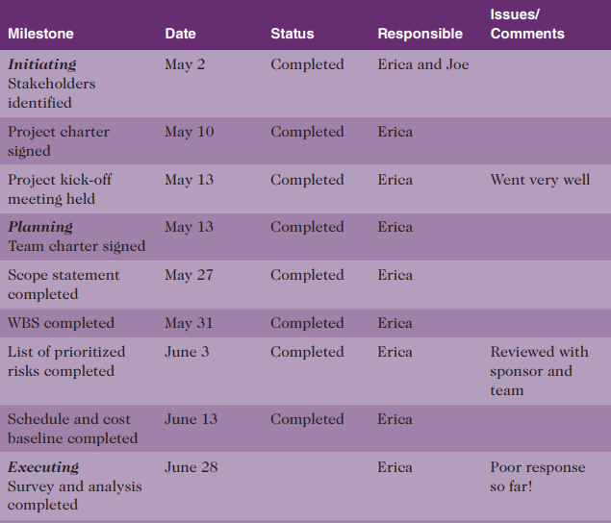
Part of Milestone Report (partial)

Slide 40
Project Monitoring and Controlling
Involves measuring progress toward project objectives, monitoring deviation from the plan, and taking correction actions
Affects all other process groups and occurs during all phases of the project life cycle
Outputs include performance reports, change requests, and updates to various plans

Slide 41
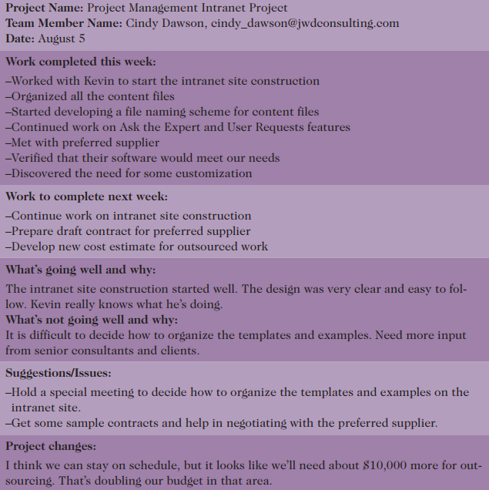
Sample weekly progress report

Slide 42

Project Closing
Involves gaining stakeholder and customer acceptance of the final products and services
Even if projects are not completed, they should be closed out to learn from the past
Outputs include project files and lessons-learned reports, part of organizational process assets
Most projects also include a final report and presentation to the sponsor/senior management

Slide 43
case study 2: jWd cOnsuLting’s PrOject ManageMent intranet site PrOject (Agile aPPrOach)

Slide 44
Scrum Roles
Product owner: The person responsible for the business value of the project and for deciding what work to do and in what order, as documented in the product backlog.
In this case, Joe Fleming is the product owner. He is the CEO of JWD Consulting and the person who suggested the project
ScrumMaster: The person who ensures that the team is productive, facilitates the daily Scrum, enables close cooperation across all roles and functions, and removes barriers that prevent the team from being effective.
In this case, Erica Bell will take on the challenge and serve as the ScrumMaster
Scrum team or development team: A cross-functional team of five to nine people who organize themselves and the work to produce the desired results for each sprint, which normally lasts 2-4 weeks.
In this case, Michael Chen, Jessie Faue, Kevin Dodge, Cindy Dawson, Kim Phuong, and Page Miller are development team members.

Slide 45
Scrum Artifacts
An artifact is a useful object created by people
Scrum artifacts include:
Product backlog: A list of features prioritized by business value
Sprint backlog: The highest-priority items from the product backlog to be completed within a sprint
Burndown chart: Shows the cumulative work remaining in a sprint on a day-by-day basis

Slide 46
Scrum Ceremonies
Sprint planning session: A meeting with the team to select a set of work from the product backlog to deliver during a sprint.
Daily Scrum: A short meeting for the development team to share progress and challenges and plan work for the day.
Sprint reviews: A meeting in which the team demonstrates to the product owner what it has completed during the sprint.
Sprint retrospectives: A meeting in which the team looks for ways to improve the product and the process based on a review of the actual performance of the development team.

Slide 47
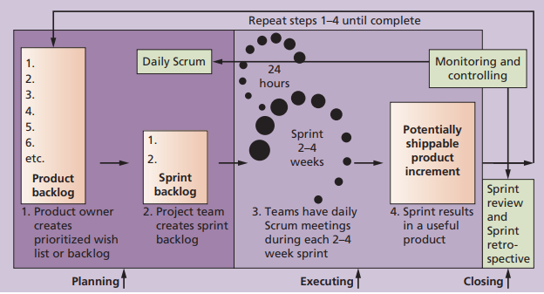
Scrum Framework and the Process Groups

Slide 48
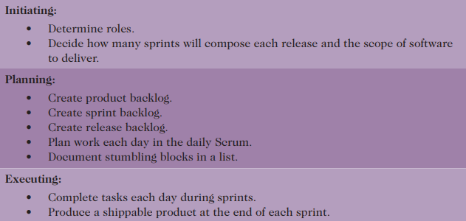
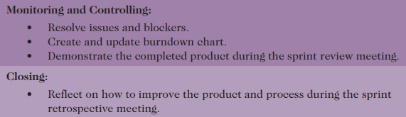
unique Scrum Activities by Process Group

Slide 49
Project Pre-initiation and initiation
The main differences between pre-initiation in this case and the first case would be determining roles and deciding what functionality would be delivered as part of each release, how many sprints will be required to complete a release, and how many releases of software to deliver.
A project charter, stakeholder register, stakeholder management strategy, and kick-off meeting would still be created as part of initiation

Slide 50
Planning
Instead of creating a team charter, WBS, Gantt chart, and list of prioritized risks for the whole project, the team follows the Scrum method.
A preliminary scope statement for the entire project can still be a useful tool for planning.
Because Scrum implies that team members work as a self-directed group, coached by the ScrumMaster, a team charter should not be necessary.
In place of a WBS, high-level descriptions of the work to be completed would be identified in the product and sprint backlogs.
The Scrum team breaks down the items in the sprint backlog into more specific work items, often in the form of user stories, technical stories, and related tasks.
User stories are short descriptions written by customers of what they need a system to do for them
A Gantt chart for the entire project could still be created.

Slide 51
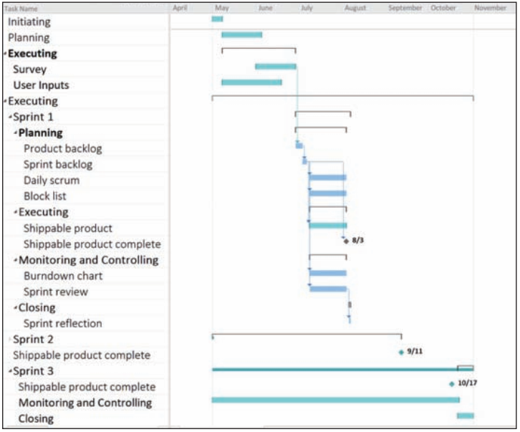
Intranet Site Project Baseline Gantt Chart Using Scrum Approach

Slide 52
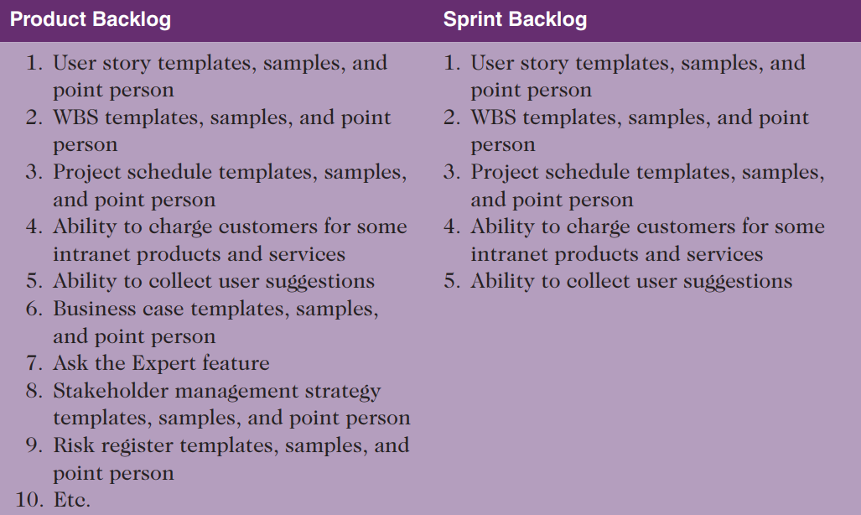
Product and Sprint Backlogs

Slide 53
Executing
Not different from PMBOK® Guide
Still produce products, lead people, etc.
Different:
Produce several releases of software - users of the new software might be confused by getting several iterations of the product instead of just one
Communications different because the project team meets every morning, physically or virtually

Slide 54
Monitoring and Controlling
Not different from PMBOK® Guide
Still check actual work vs. planned work
Different
Names of key reviews are the daily Scrum and the sprint review
A sprint board is used instead of a tracking Gantt chart or other tools
Use a burndown chart vs. earned value chart

Slide 55
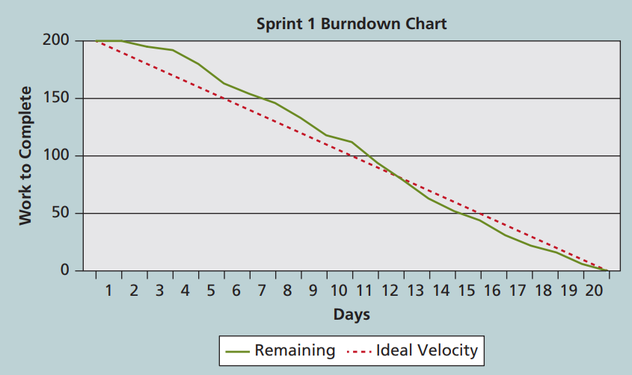
Burndown Chart

Slide 56
Closing
Not different from PMBOK® Guide
Focus is still on acceptance of deliverables and reflection
Different:
The retrospective is similar to a lessons-learned report, but it focuses on a shorter period of time. It is intended to answer two fundamental questions:
What went well during the last sprint that we should continue doing?
What could we do differently to improve the product or process?

Slide 57
Chapter Summary
The five project management process groups are initiating, planning, executing, monitoring and controlling, and closing
You can map the main activities of each process group to the nine knowledge areas
Some organizations develop their own information technology project management methodologies
The JWD Consulting case study provides an example of using the process groups and shows several important project documents
The second version of the same case study illustrates differences using agile (Scrum). The biggest difference is providing three releases of useable software versus just one

